Slide 1
Implementation of the Water Resources Classification System and Determination of the Resource Quality Objectives for Significant Water Resources in the Letaba Catchment
7: Operational scenarios: Recap, description and yield consequences
3 April 2014
Presented by:
Pieter van Rooyen

Slide 2
Letaba NWRCS steps
1: Delineate units of analysis and describe the status quo
2: Initiation of stakeholder process and catchment visioning
3: Quantify EWRs and changes in Ecosystem Services
7: Gazette class configuration
4: Identification and evaluation of scenarios within IWRM
5: Draft Management Classes
6: Resource Quality Objectives (EcoSpecs & water quality (user))
Scenario Analysis: Where does it fit in?

Slide 3
What are scenarios?
Scenarios, in context of water resource management and planning are plausible definitions (settings) of all the factors (variables) that influence the water balance and water quality in a catchment and the system as a whole

Slide 4
What are scenarios used for?
Different levels of water use and protection are evaluated with the aim to find a balanced scenario
Water Resource Classification is the process to evaluate and recommend what that balance scenario entails

Slide 5
Evaluation of Scenarios
Entry
Scenario Description
Assign attributes to EWR nodes
Water
Availability Analysis
Estimate Consequences
Rank and
optimise
Formulate Alternative Scenarios
Select Scenario Subset
Stakeholder Evaluation
Ecological
EGSA
Economical
Non-Ecological Water Quality

Slide 6
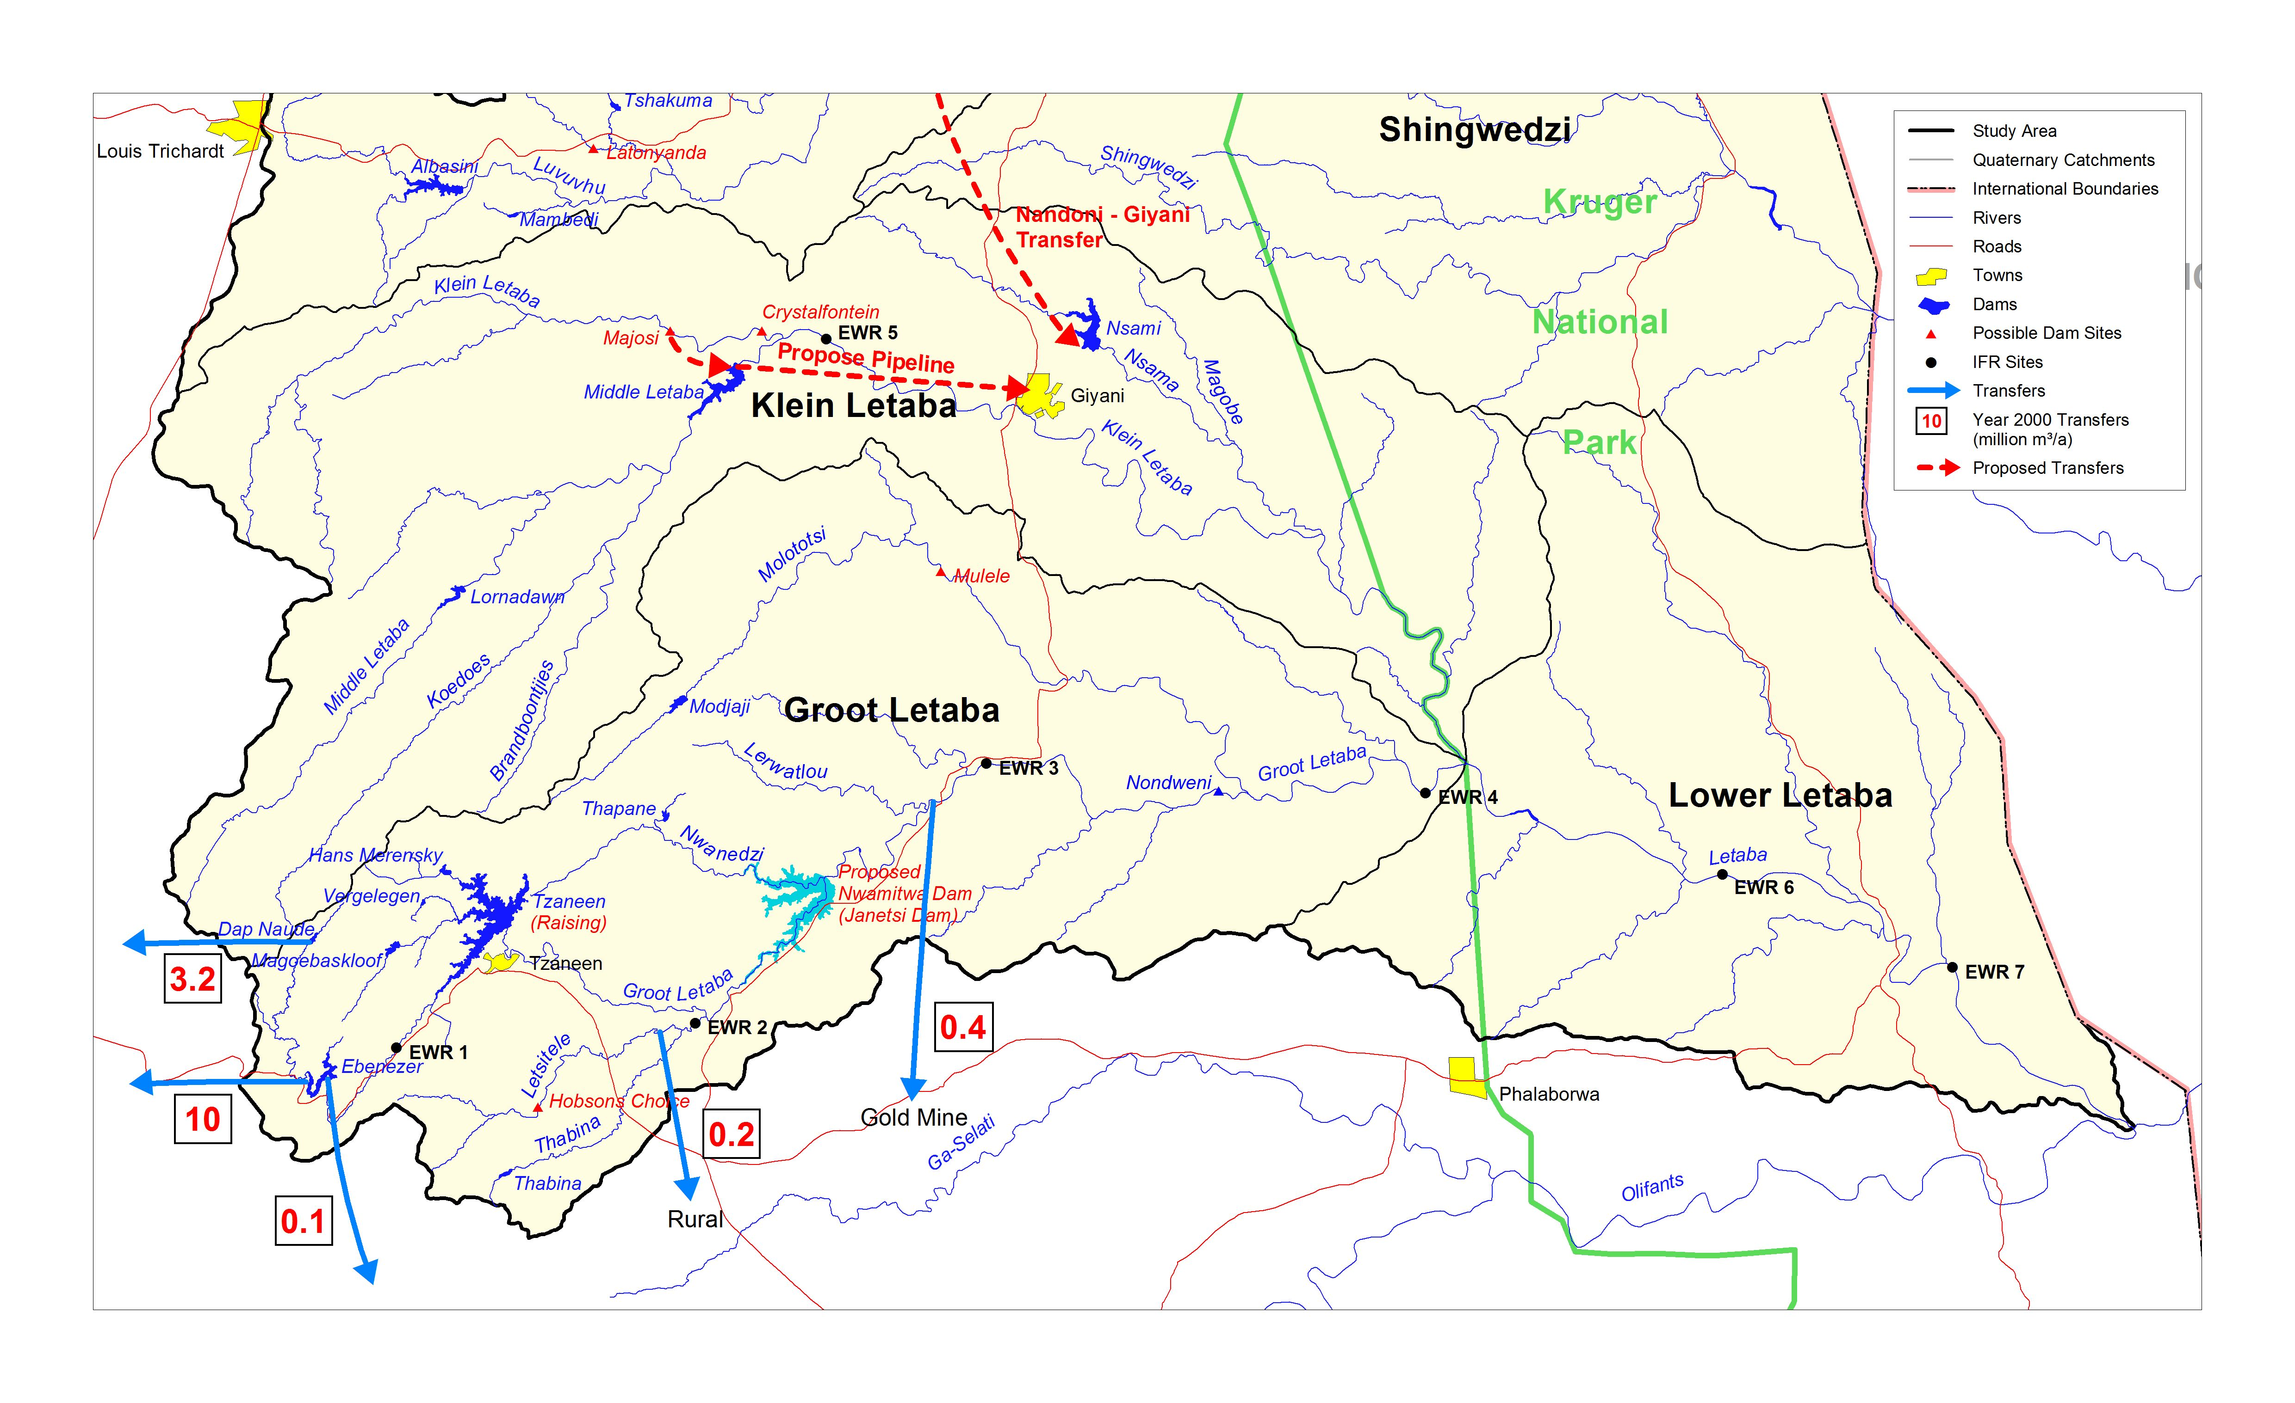
Letaba River System

Slide 7
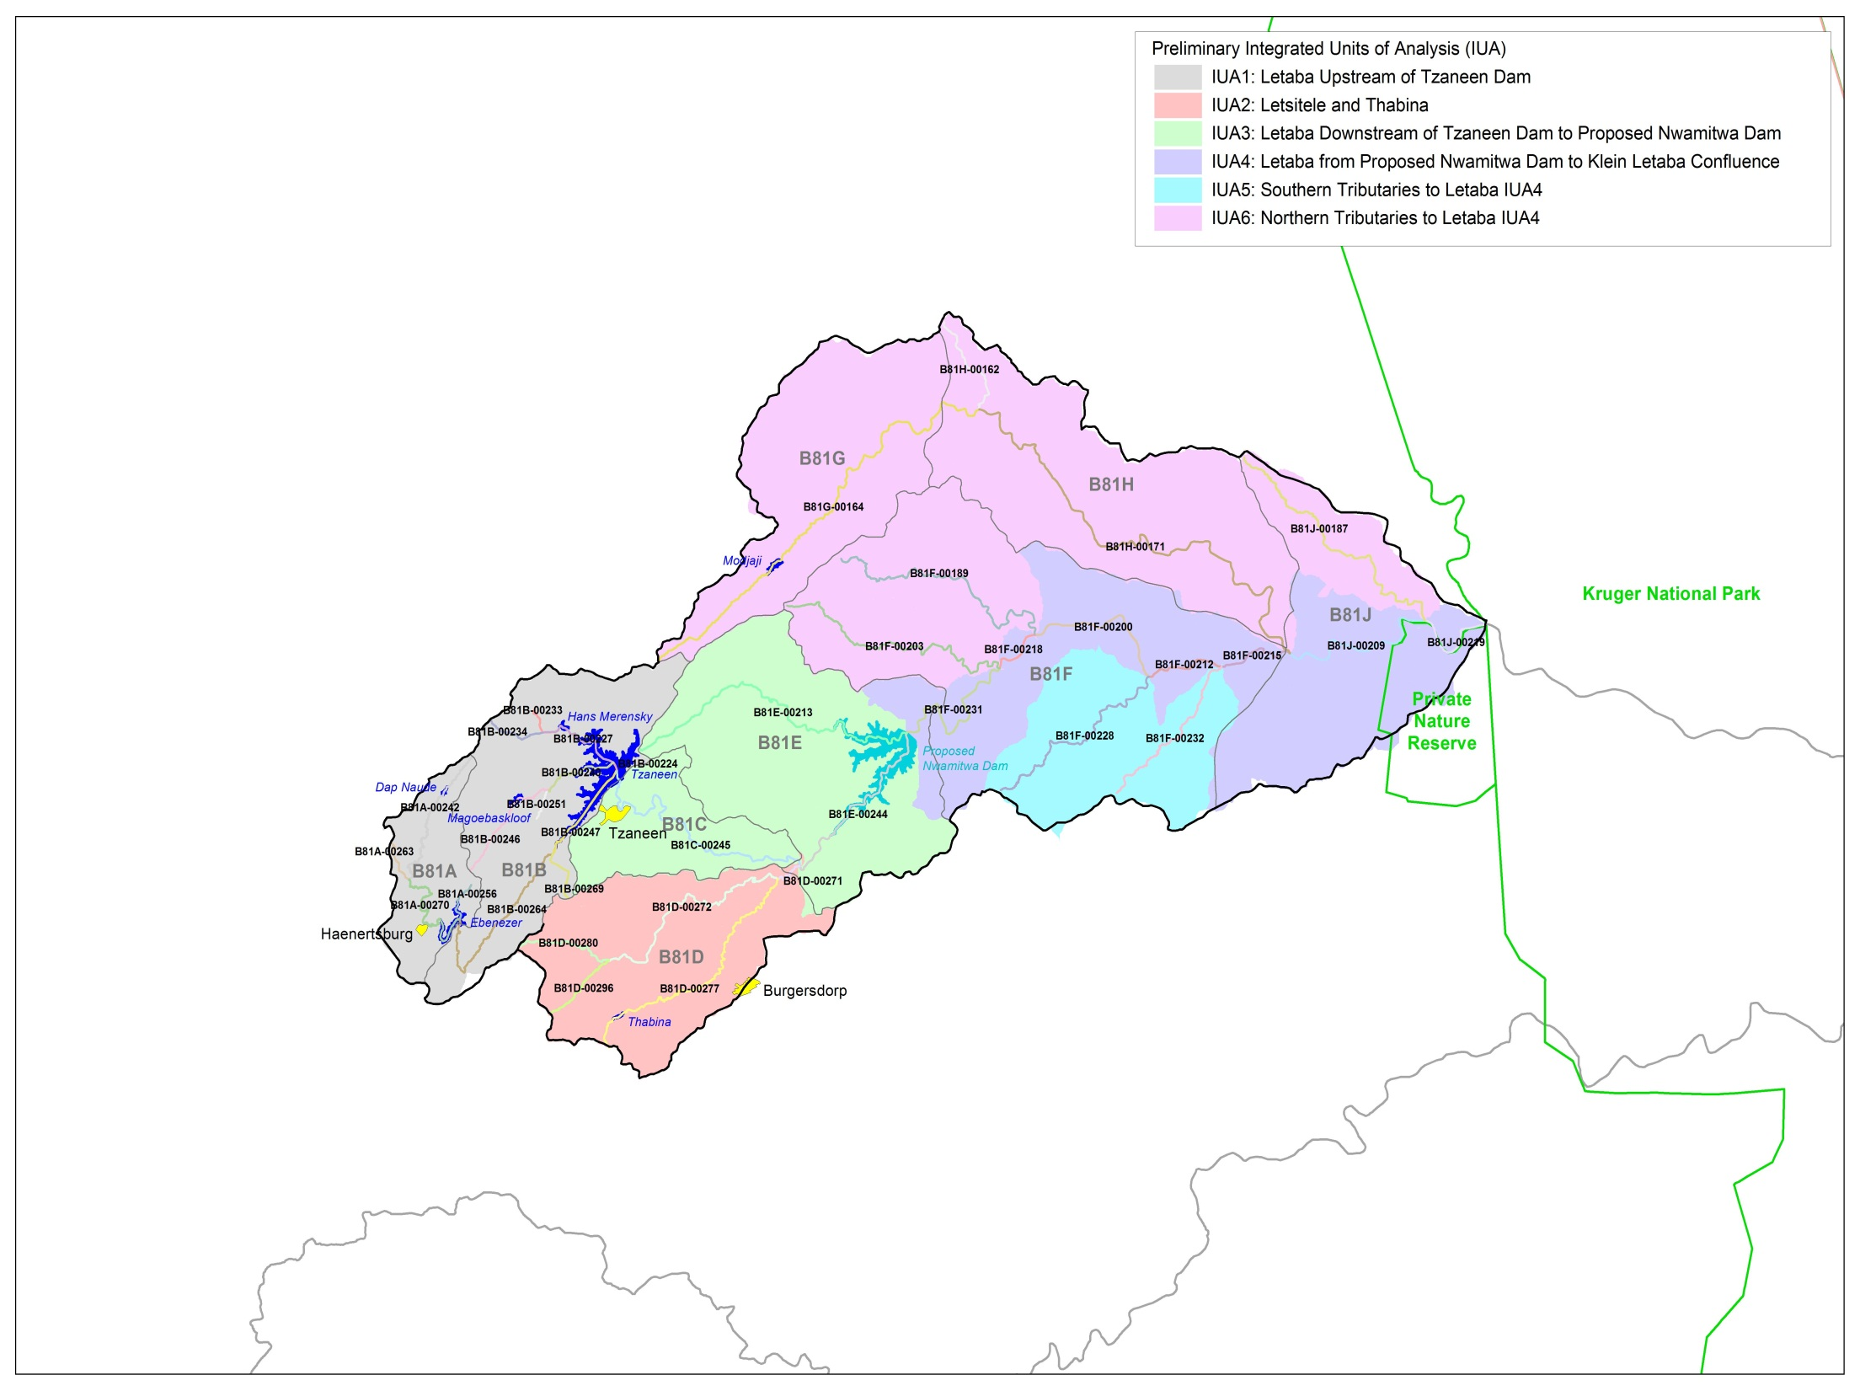
Scenarios in context of IUAs
Letaba u/s Tzaneen Dam
Approved: Groot Letaba River Water Development Project : Raising of Tzaneen Dam
Applications:
Abstraction to Polokwane
Politsi Scheme
Molatotsi River
Option for evaluation, Artificial aquifer recharge at Mulele .
Letaba d/s Tzaneen Dam to Proposed Nwamitwa Dam
Approved: Groot Letaba River Water Development Project : Nwamitwa Dam
Letsitele and Thabina
Option for evaluation, Letsitele River Valley Dam

Slide 8
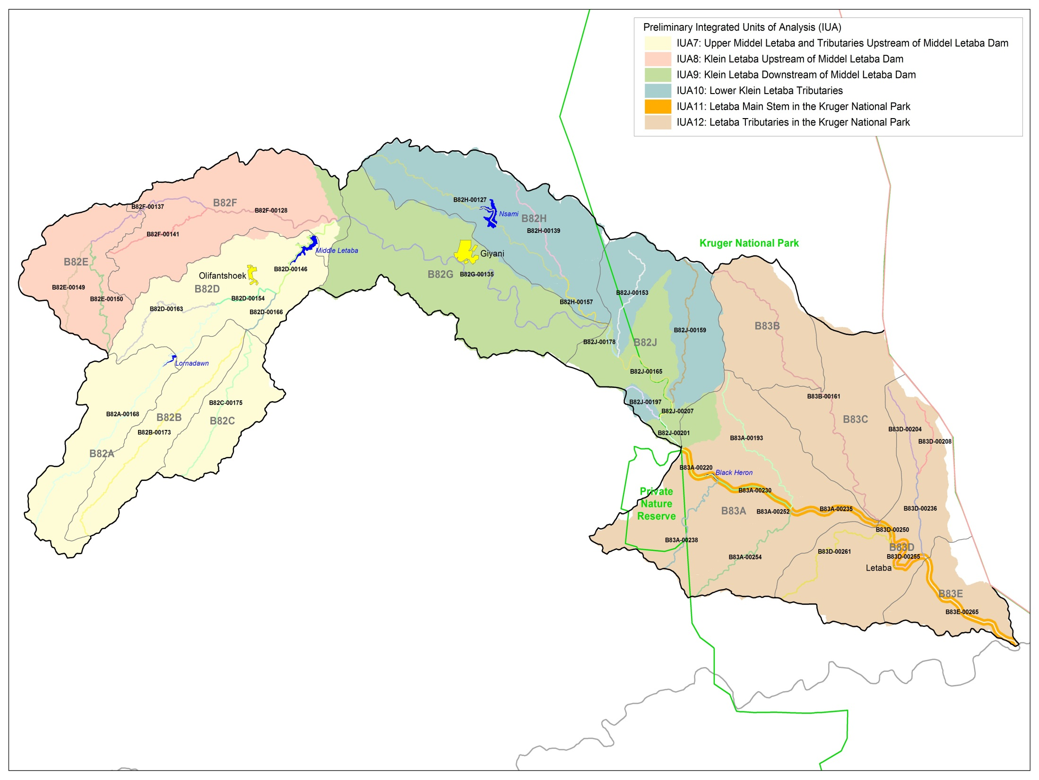
Klein Letaba u/s Middel Letaba Dam
Option for evaluation: Crystalfontein Dam and conveyance infrastructure
Klein Letaba d/s Middel Letaba Dam
Pipeline to replace canal, reducing losses
Scenarios in context
of IUAs

Slide 9
Scenarios
Total of 18 scenarios were considered (see hand-out)
Components were defined at previous SSC
Initial set provided perspective on the boundaries of the variables assessed.
Alternative scenarios was analysed to improve certain aspects – find a balance between protection and use.
Six scenarios were identified for stakeholder evaluations.

Slide 10
Present Day Scenario (1 of 6)
Present Water Resource Infrastructure
Present day abstractions and supply
Minimum flow of 0.6 m3/s into Kruger National Park
Serve as reference scenario
Reference scenario, present conditions

Slide 11
REC Scenario (2 of 6)
Water Resource Infrastructure:
Raising of Tzaneen Dam
Nwamitwa Dam implemented
Additional transfer to Polokwane (full yield)
Crystalfontein Dam
Recommended Ecological Category:
High and low flows EWR 3, 4, 5 and 7
Low flows at EWR 1
Current drought restriction operating policy
Determine reduction in supply if releases for Recommended Ecological Categories Scenario is made

Slide 12
Scenario 5 (3 of 6)
Water Resource Infrastructure:
Raising of Tzaneen, Nwamitwa Dam implemented
Additional transfer to Polokwane (licence request)
Crystalfontein Dam
Letsitele River Dam
Maximum groundwater abstraction
No releases for ecology
Maximum supply to economic activities

Slide 13
Scenario 6 (4 of 6)
Water Resource Infrastructure:
Raising of Tzaneen, Nwamitwa Dam implemented
Additional transfer to Polokwane (licence request)
Crystalfontein Dam
Letsitele River Dam
Maximum groundwater abstraction
PES low flows (no high flows)
Water use:
Current abstractions Groot Letaba System
Increased abstraction from Crystalfontein Dam
Improve Scenario 5 ecology - PES low flows

Slide 14
Scenario 9 (5 of 6)
Water Resource Infrastructure:
Raising of Tzaneen Dam
Nwamitwa Dam implemented
Additional transfer to Polokwane (licence request)
Crystalfontein Dam
Low flows for REC (1 high flow event in year)
Determine available supply for users
Increase low flows from Scenario 6 (PES to REC) and add high flow event

Slide 15
Scenario 10 (6 of 6)
Water Resource Infrastructure:
Raising of Tzaneen Dam
Nwamitwa Dam implemented
Additional transfer to Polokwane (licence request)
Crystalfontein Dam
PES low flows (3 high flow events - Groot Letaba)
Determine available supply for users
Exchange (reduce) low flow from Scenario 9 (REC to PES) and add 2 high flow events

Slide 16
Catchment Analysis
Catchment Resource Availability
Ecological
Water Requirements
Socio-Economic
Water Requirements
Protection
Use
Management Class
(Decision)

Slide 17
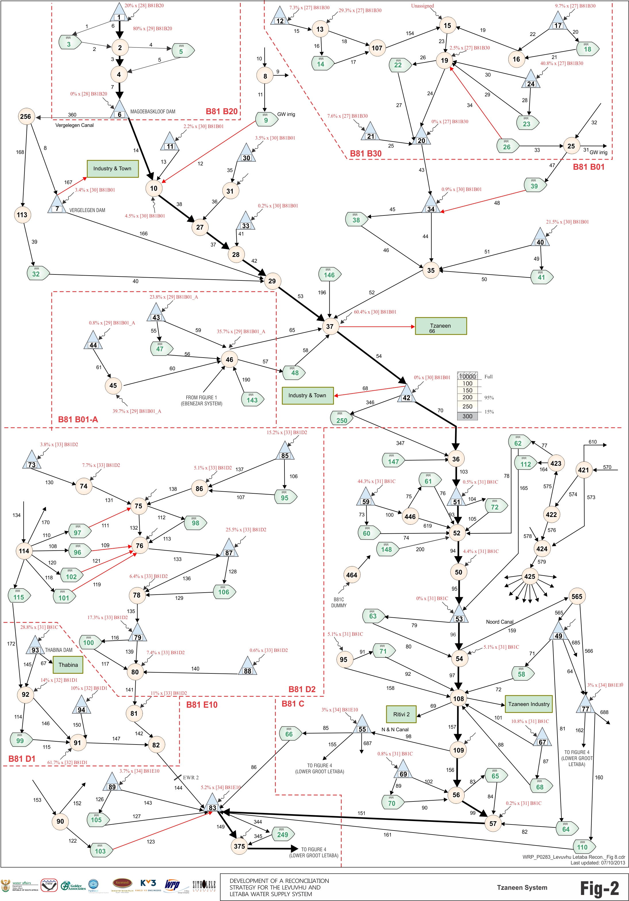
Magoebaskloof
Water Resources Network Model
(example)
Monthly time step
All water use
Groundwater use
Return flows
Vergelegin
Hans Merensky
Tzaneen
Thabina
Noord Canal
NN Canal

Slide 18
Water supply summary
Scenario | Supply to Tzaneen / Nwamitwa irrigators | Supply to Tzaneen / Nwamitwa current urban | Additional supply to Tzaneen / Nwamitwa urban | Total Supply to Tzaneen / Nwamitwa | Additional supply to Crystalfontein urban
Present Day Scenario | 66.4 | 16.2 | 0.0 | 82.6 | 0.0
REC Scenario (Ecological Recommendation) | 29.2 | 16.4 | 0.0 | 45.6 | 2
Scenario 5 | 68.1 | 16.4 | 16.0 | 100.5 | 12
Scenario 6 | 66.4 | 16.2 | 0.0 | 82.6 | 11
Scenario 9 | 67.7 | 16.1 | 5.0 | 88.9 | 9
Scenario 10 | 67.1 | 16.1 | 5.0 | 88.1 | 11
Focus on water users where changes occur between scenarios

Slide 19
Questions for clarification

